Slide 1
COMP 3354 Statistical Learning
Costa Rican Household Poverty Level Prediction
Saripalli Varun Vamsi (3035242229)
Vashishtha Anushka (3035299404)
Johar Aman (3035253888)
Tarun Sudhams (3035253876)
Singhal Rohak (3035242475)
Oka Courtney Julin (3035525839)

Slide 2
Outline
Motivation and Research Question
Exploratory Data Analysis
Data Cleansing and Feature Engineering
Statistical Learning Modeling
Gradient Boosting Machine
Results and Conclusion

Slide 3
Motivation
Income inequality rising
Extreme Poverty increased from 5.8 % to 7.2%
More than 20 social programs
Goals
Identify factors best related to poverty
Effectively gauge amount of funds to be distributed
Improve economic conditions of poorest segment
Notes:
Here's the backstory: Many social programs have a hard time making sure the right people are given enough aid. It’s especially tricky when a program focuses on the poorest segment of the population. The world’s poorest typically can’t provide the necessary income and expense records to prove that they qualify.
Stats on world poverty.
Talk about the dataset
Author
Important Fields / Columns (pick from EDA part)

Slide 4
Research Question
How do we effectively determine the right amount of aid to be given to a household?

Slide 5
Exploratory Data Analysis

Slide 6
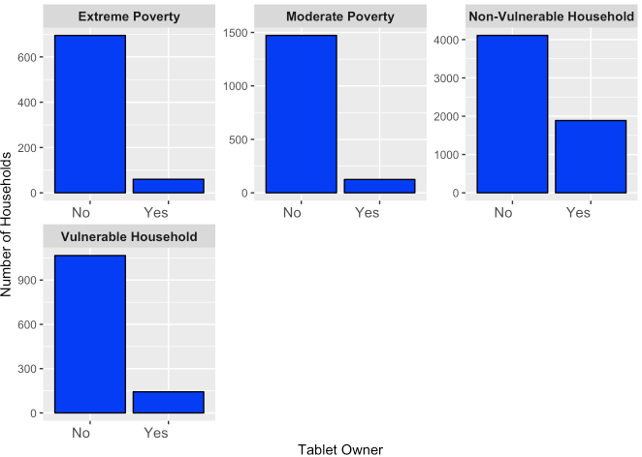
Association between no. of tablets and household classes

Slide 7
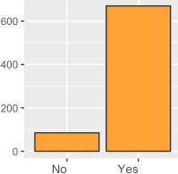
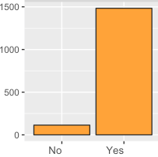
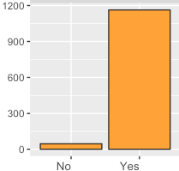
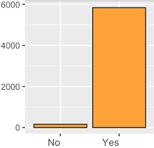
Association between refrigerator ownership and household classes
Extreme Poverty
Moderate Poverty
Non Vulnerable Households
Number of households
Vulnerable Households
Owns a refrigerator or not

Slide 8
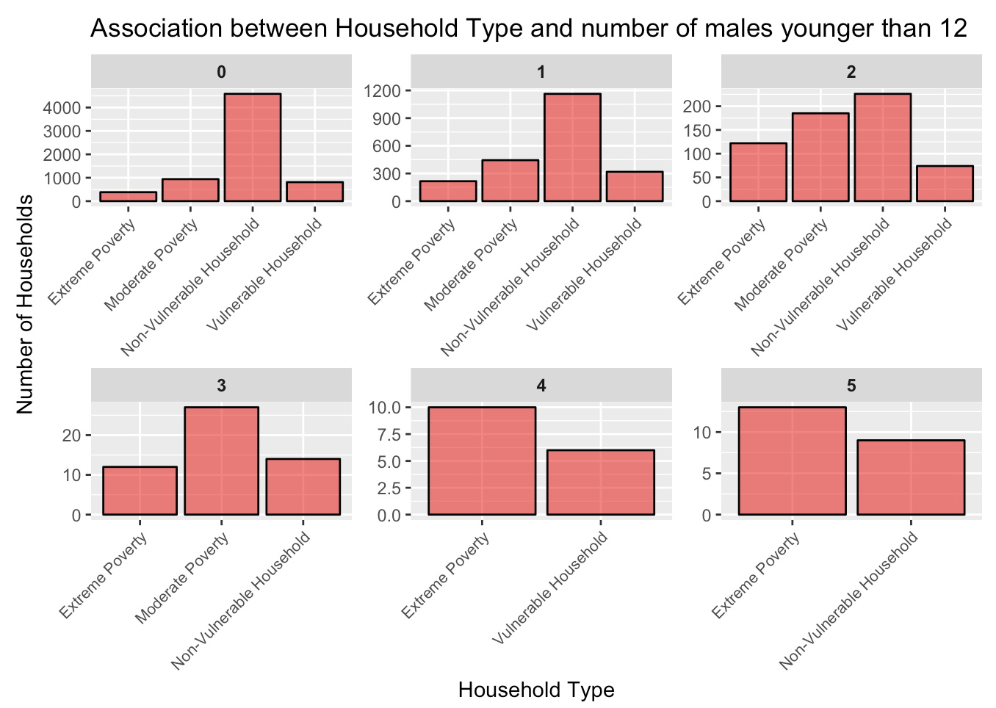
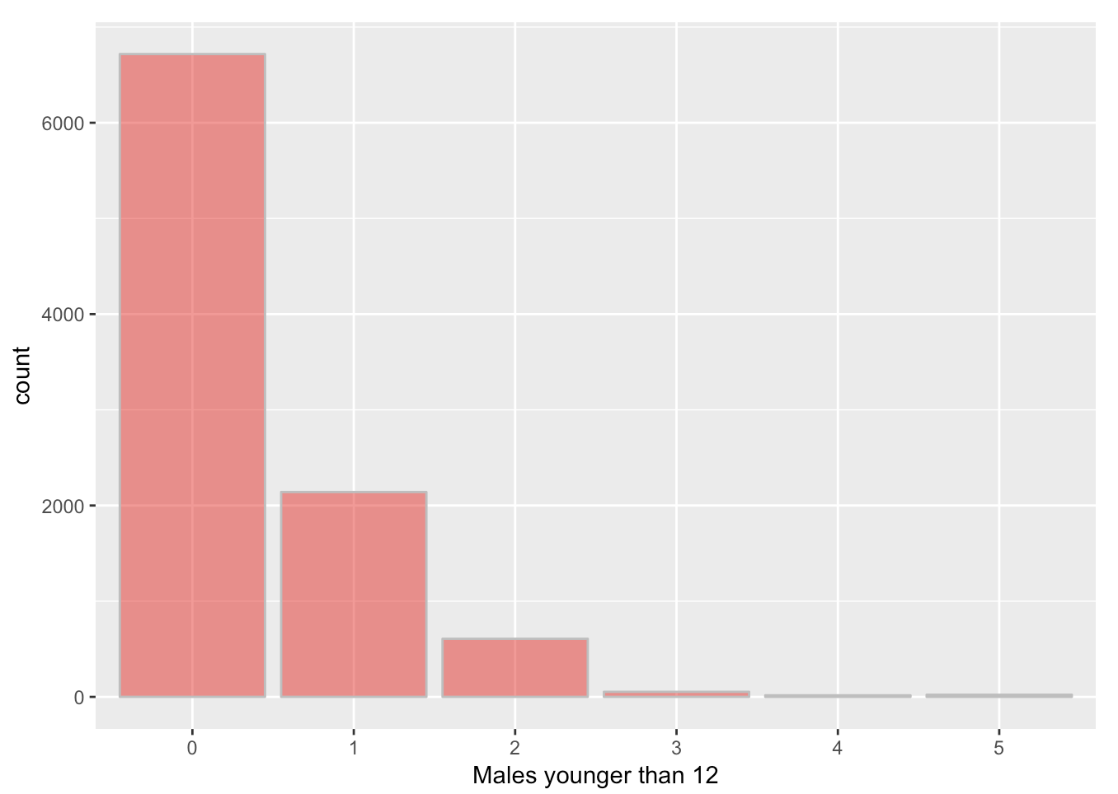
Male Distribution
Households with higher no. of males younger than 12 tend to be in extreme poverty or are non-vulnerable

Slide 9
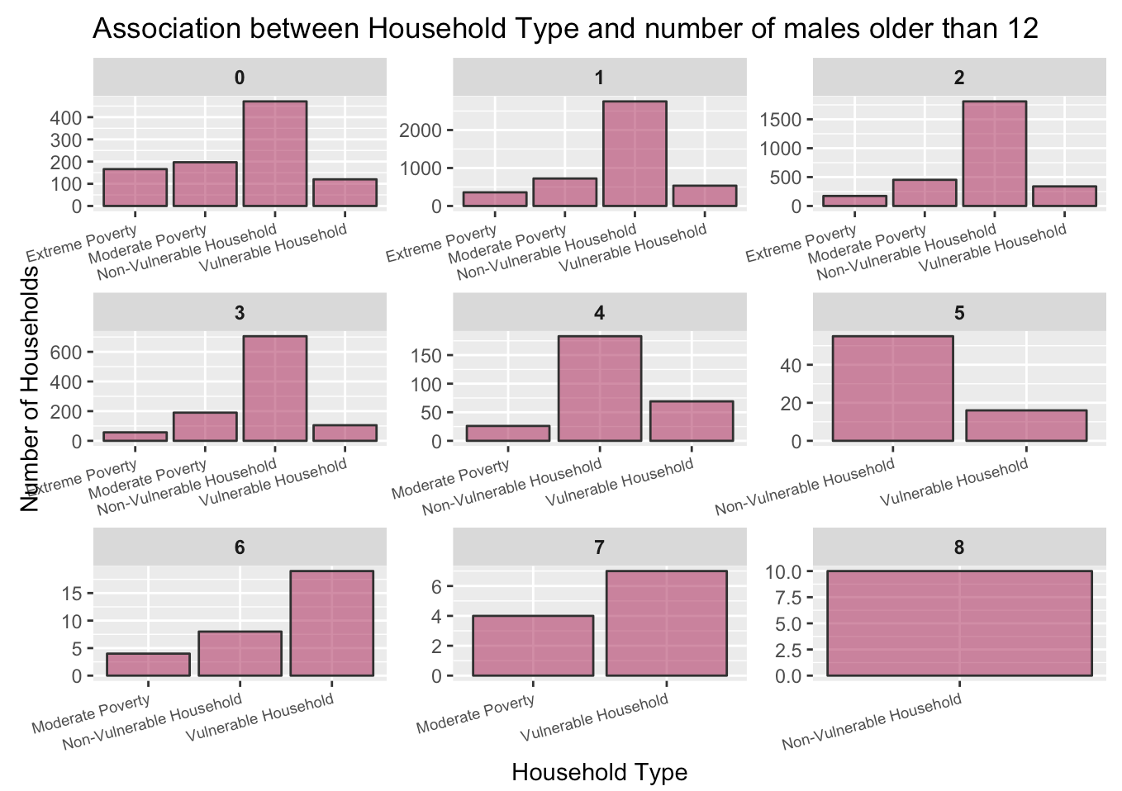
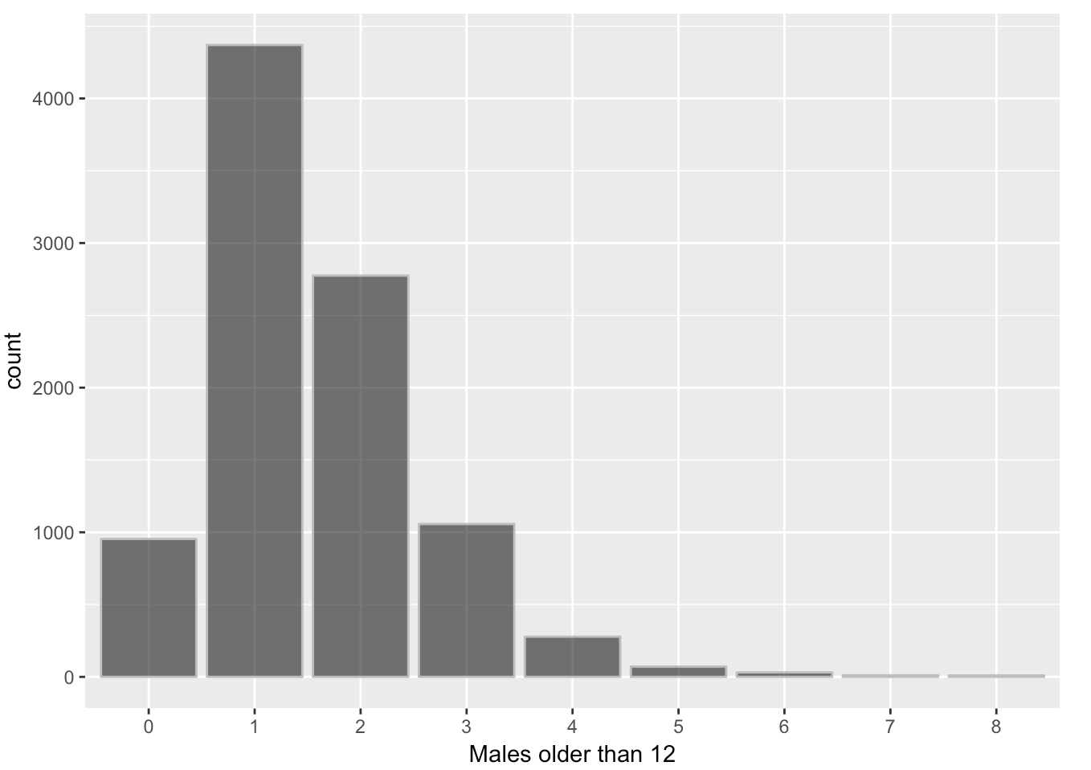
Male Distribution
If higher number of males older than 12 are present then the household tends not to be in extreme poverty

Slide 10
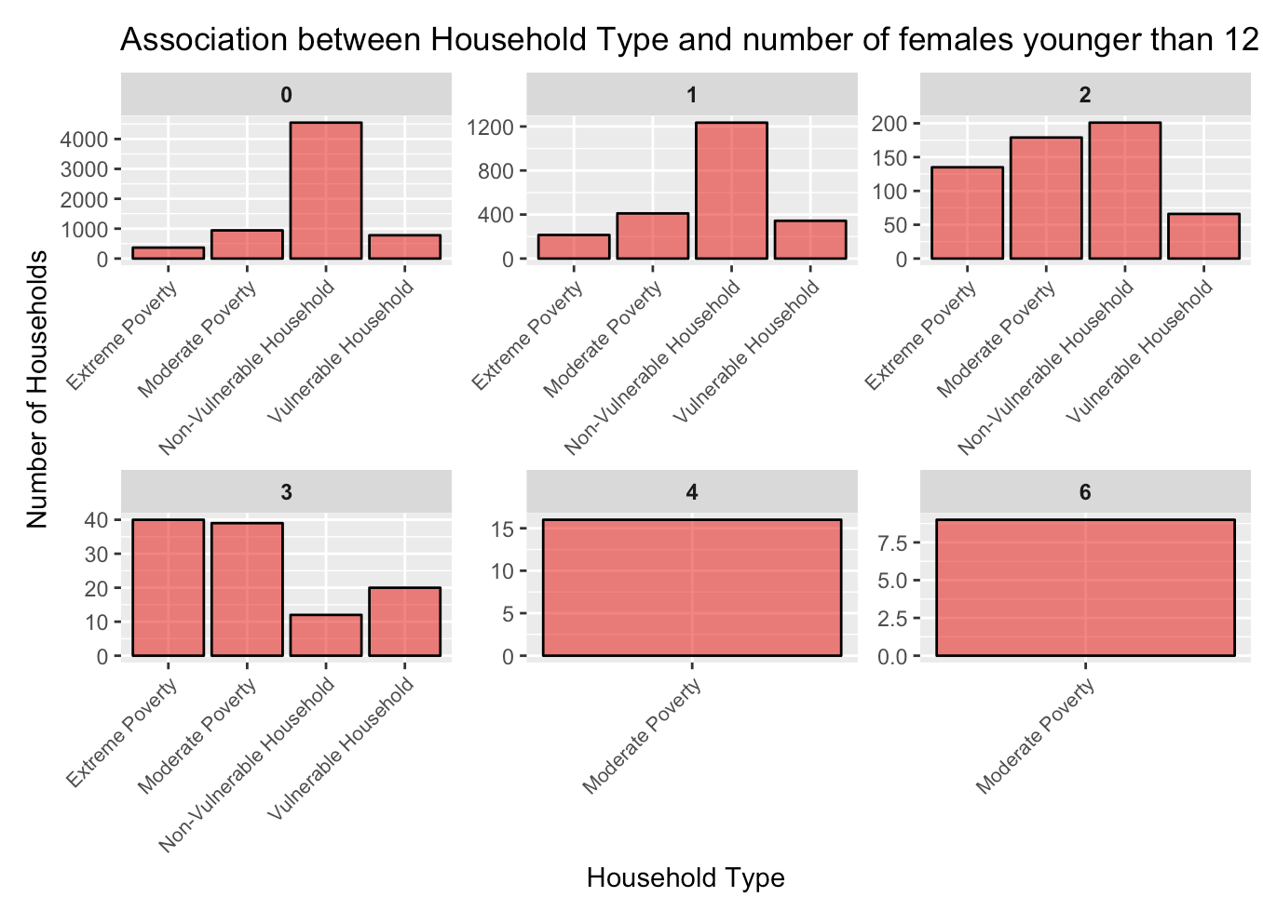
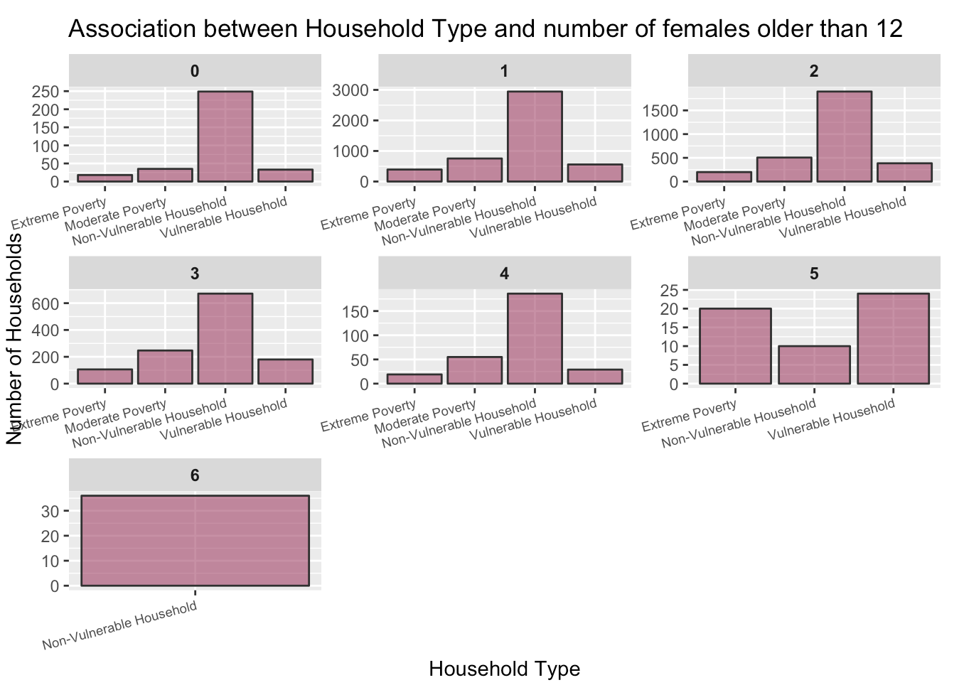
Female Distribution
Higher no. of females younger than 12 ➡ moderate poverty household
Higher no. of females older than 12 ➡ non-vulnerable household

Slide 11
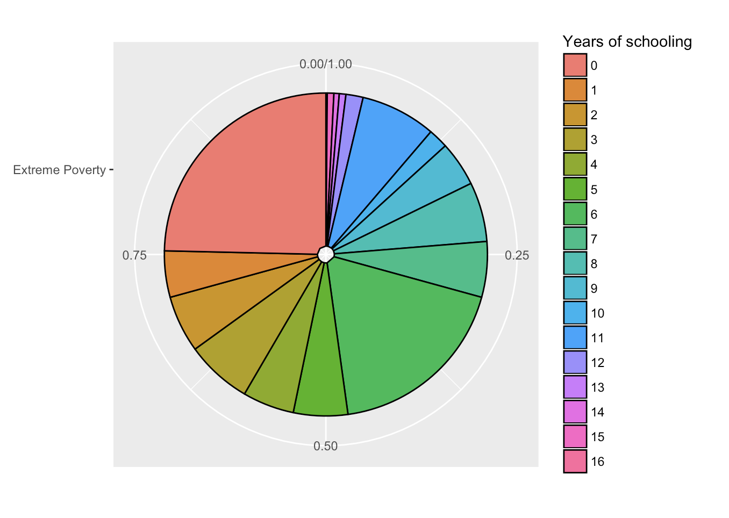
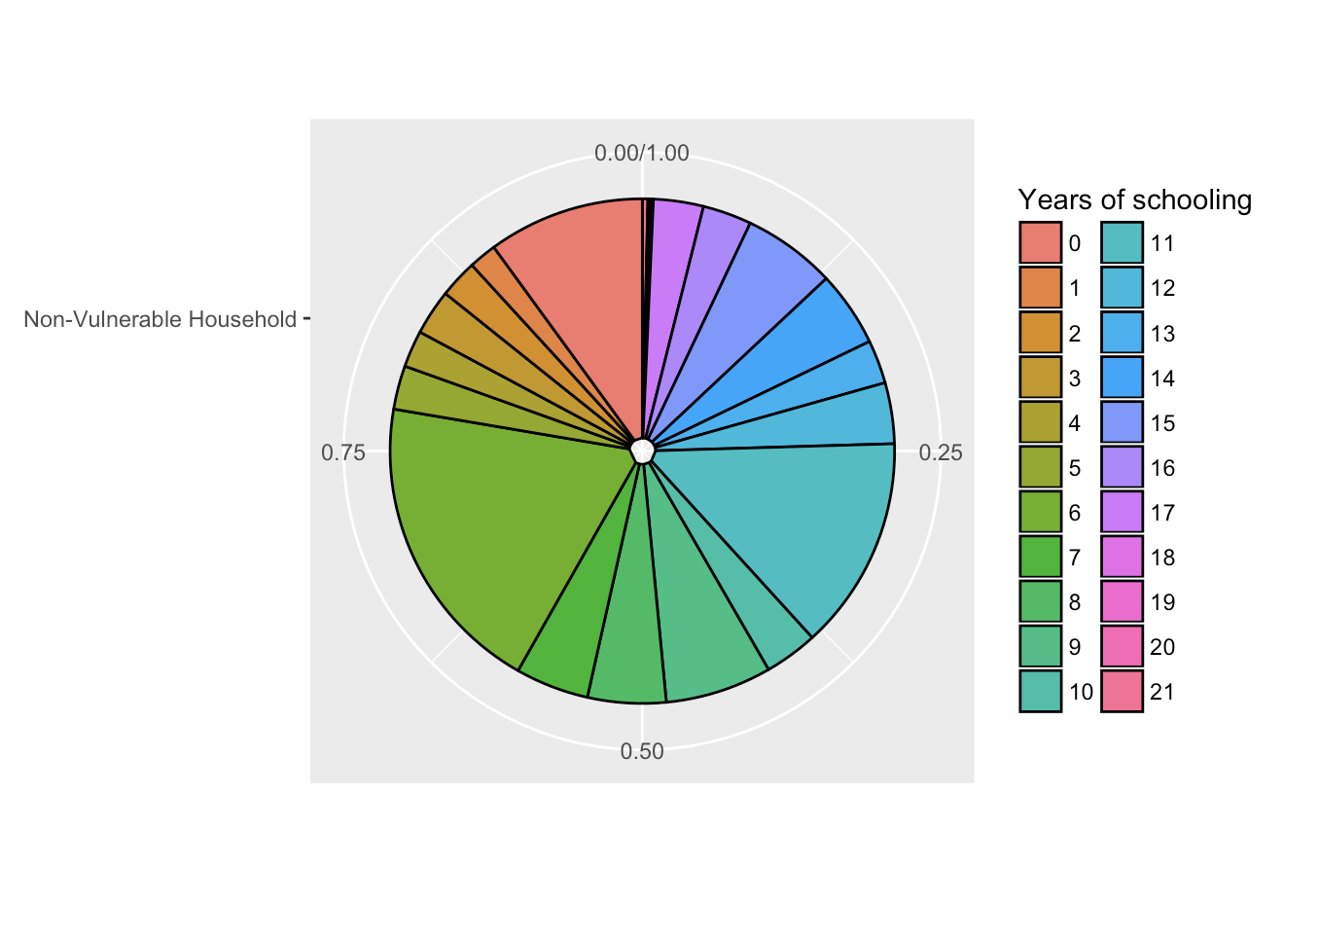
Years of Schooling
Extreme Poverty
Non-Vulnerable Households

Slide 12
Data Cleaning
Applying common target variable to each member of a household
Filling missing values
v18q1 [No. of tablets]
v2a1 [Monthly rent payment] - 0 for owned homes else flag
rez_esc [Years behind in school]
Defined for age group 7-19
Flag is not in group else 0

Slide 13
Feature Engineering

Slide 14
The Variables
Individual Variables
Household Variables
ID
Variables
These are characteristics of each individual rather than the household
Characteristics of the household
These are kept for identification
Male or Female
Married or Divorced
Level of Education
Household Size ( hhsize )
Ceiling or not ? ( cielorazo )
If no electricity in the dwelling ( noelec )
ID
Target

Slide 15
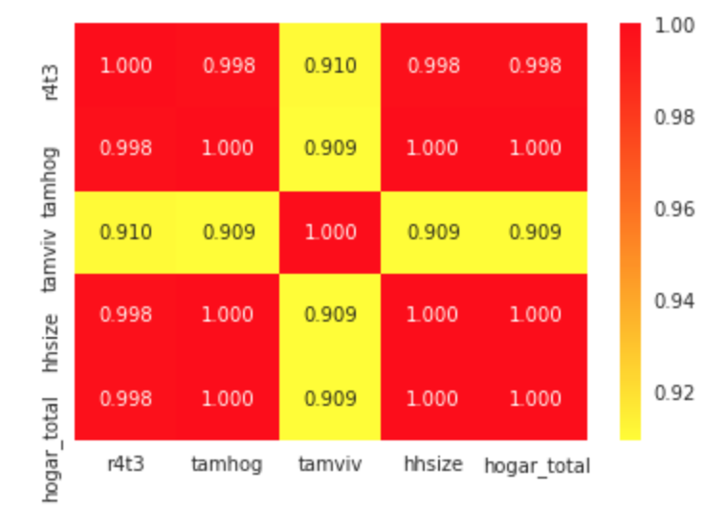
Step 1 - Remove Redundant Variables
Strong correlation between hhsize, r4t3 and tamhog and hogar_total
We keep hhsize and remove the rest

Slide 16
Step 2 - Creating Ordinal Variables
No electricity (0,1)
0
Electricity from cooperative (0,1)
1
Compress multiple into one by creating an ordinal variable
We map the description based on the data description given to us in the problem
Electricity (0,1,2,3)
Electricity from CNFL, ICA, ESPH/JASEC (0,1)
2
Electricity from private plant (0,1)
3

Slide 17
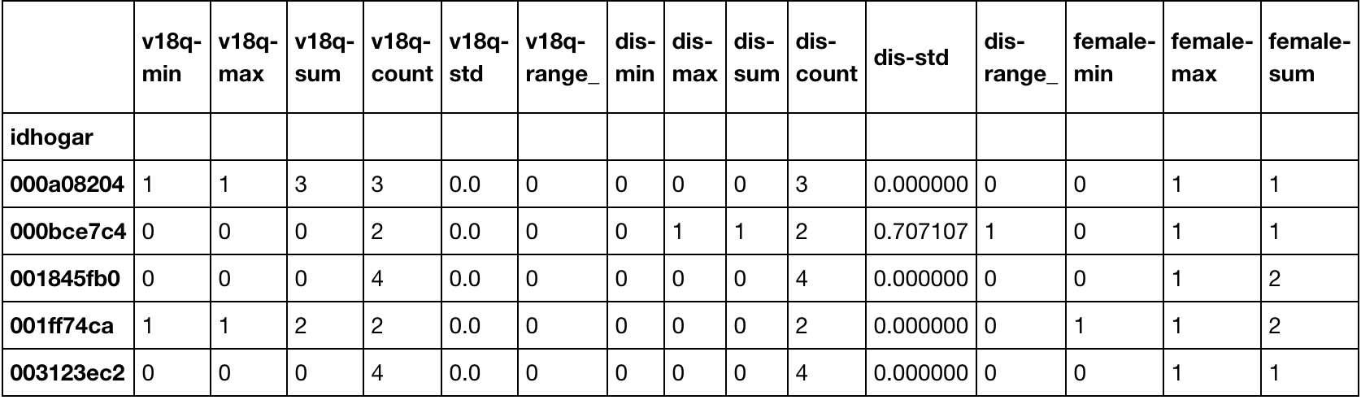
Final Step - Feature Aggregation
Incorporate individual data into household data
Group the data by family ID ( idhogar ) and then aggregate
Aggregate Variables

Slide 18
Statistical Learning Modelling

Slide 19
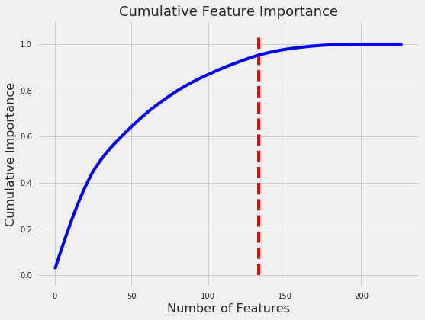
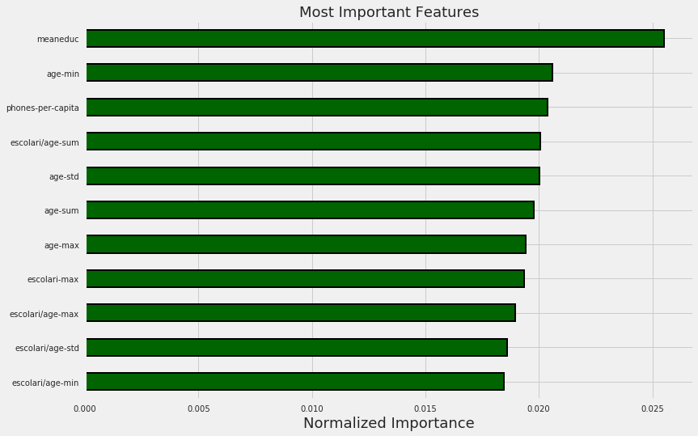
Feature Importance
133 features correlate to 95% of the data given to us
Graph showing the most important features in the dataset
(Random Forest Classifier F1 Score: 0.352)

Slide 20
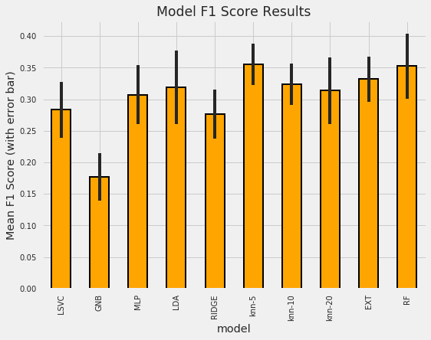
Model Selection
We compared the F1 scores of following models:
Random Forest Classifier
Linear Support Vector Classifier
Multilayer Perceptron
Linear Discriminant Analysis
RIDGE Classifier
KNN Classifier with 5, 10 and 20 neighbours
Extra Trees Classifier
We found that Random Forest Classifier performed the best for our use case.
Hyper Optimization possible but won’t be of much use
Comparative view of F1 scores of 8 models
Notes:
Ridge regression is an extension for linear regression. It’s basically a regularized linear regression model. The λ parameter is a scalar that should be learned as well, using a method called cross validation

Slide 21
Gradient Boosting Machine

Slide 22
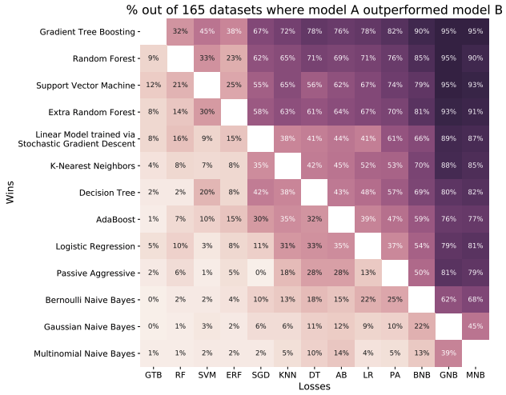
Data-driven advice for applying machine learning to bioinformatics problems
Randal S. Olson, William La Cava, Zairah Mustahsan, Akshay Varik, and Jason H. Moore
Notes:
The algorithms are ordered from top to bottom based on their overall performance on all problems.
Two algorithms are considered to have same performance if they achieved an accuracy within 1% of each other
However, in machine learning, there is no way to know ahead of time which model will work best for a given dataset. The following plot shows that there are some problems where even Gaussian Naive Bayes will outperform a gradient boosting machine.
In most cases the accuracy gain is less than 10% so the worst model is probably not suddenly going to become the best model through tuning.
https://raw.githubusercontent.com/WillKoehrsen/Machine-Learning-Projects/master/algorithm_comparison.png
https://arxiv.org/pdf/1708.05070.pdf
http://www.epistasisblog.org/2017/09/data-driven-advice-for-applying-machine.html

Slide 23
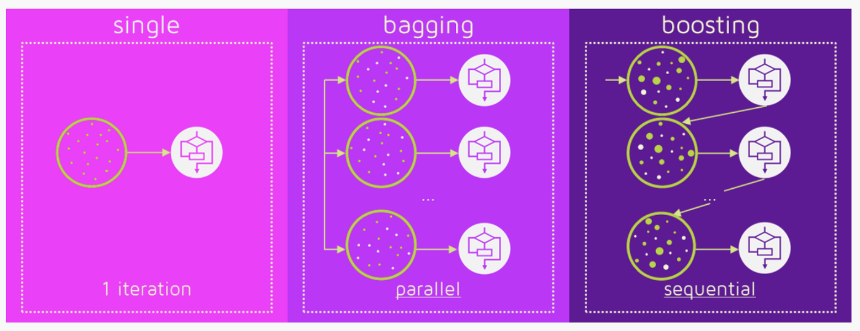
Ensemble Learning - Boosting

Slide 24
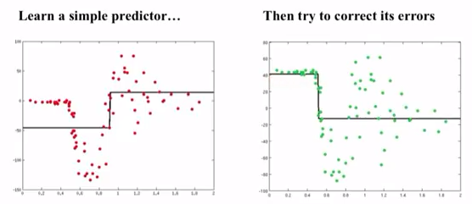
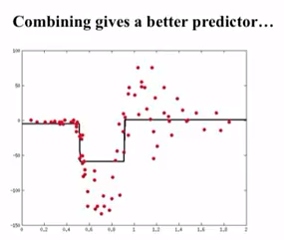
Gradient Boosting Machine - Algorithm
￼
Learn a predictor
Compute the error residual
Learn to predict the residual
Combine predictors, back to step 2

Slide 25
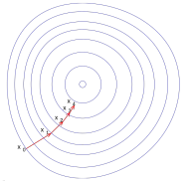
Gradient Boosting Machine - Components
Ensemble of weak learners - typically decision trees
Loss function - MSE
Using gradient descent, minimize loss function
(Learner / Model)
(Loss Function)
(Optimizer)

Slide 26
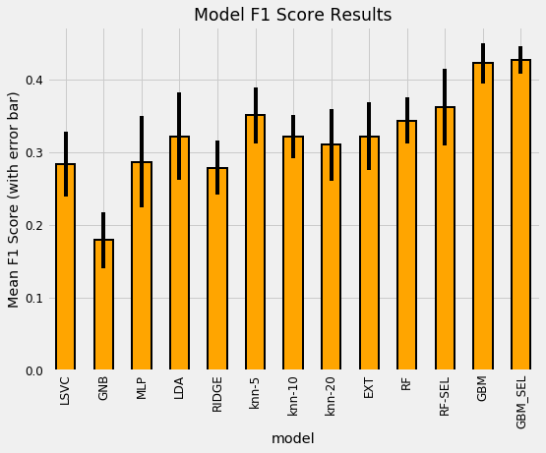
Gradient Boosting Machine - Results
GBM outperforms every other previous method!

Slide 27
Results

Slide 28
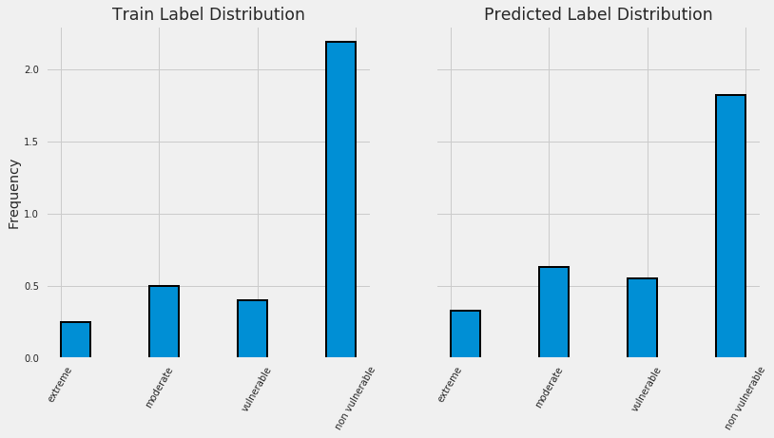
Investigate Predictions

Slide 29
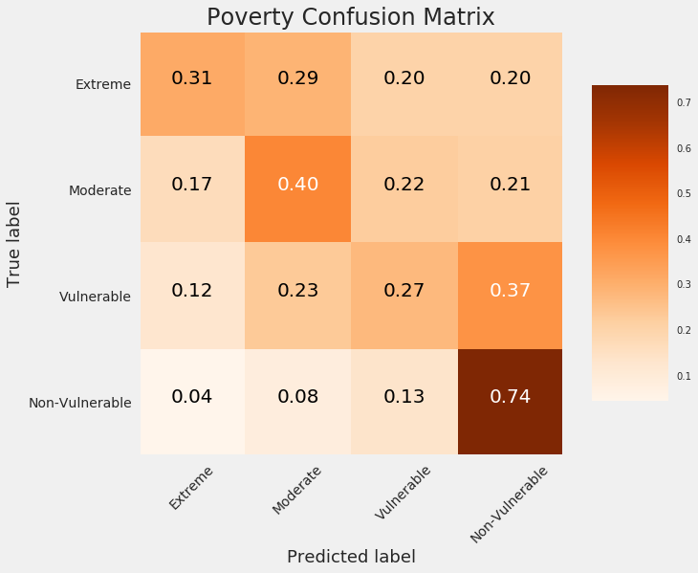
Normalized Confusion Matrix Validation
Diagonal elements are accurately predicted the label
Off-diagonal are mislabeled by model
Notes:
We wanted to see how our model would perform in turns of predicted labels versus true labels. This a graph of normalized confusion matrix validation. The diagonal elements are the accurately predicted labels and the off-diagonal values represent mislabeled values. So it’s really easy what we thought before. That we can fairly accurately predict non-vulnerable labels. However for the other labels, it doesn’t predict exact poverty level that accurately.

Slide 30
Conclusion
Classified household poverty
Identified factors best related to poverty
Various models explored
Limitations of Prediction:
Low accuracy due to the size of data available
Lack of data points on vulnerable, moderate and extreme cases
Notes:
We were able to discern the most correlated variables for household poverty in puerto rico, which could help lead future investigation efforts.
Our prediction power however was very limited. With any empirical based model building, the data is the crucial factor in shaping the results. We would need more rich data of vulnerable, moderate, and extreme poverty cases in order to continue to iterate on our model.

Slide 31
Thank you

